Slide 1
GEOMETRY & TRIGONOMETRY
FOCUS SKILL #3
Notes:
Follow “Targeted Group Practice Instructions” guidance here.

Slide 2
FOCUS SKILL
Right Triangles
and Trigonometry
Notes:
Follow “Targeted Group Practice Instructions” guidance here.

Slide 3
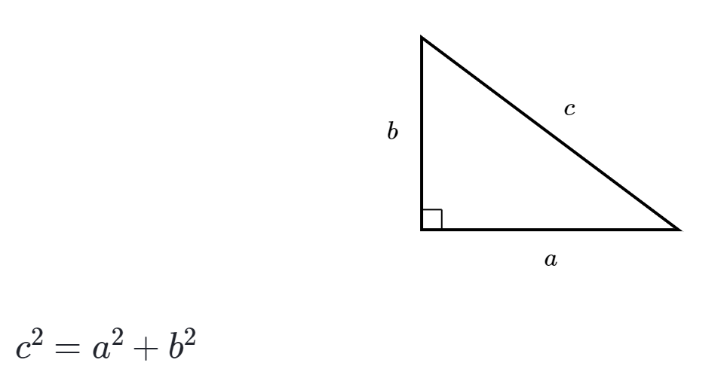
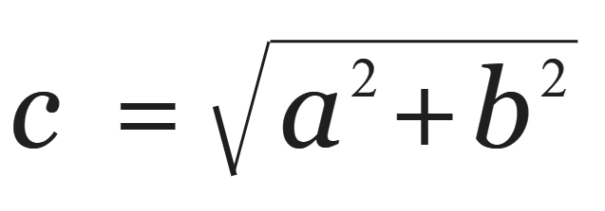
Pythagorean Theorem
Used to find the side lengths
of a RIGHT triangle
a = leg
b = leg
c = hypotenuse
See also: Pythagorean triples (e.g., 3, 4, 5)
Notes:
Pythagorean Theorem used on RIGHT triangles only

Slide 4
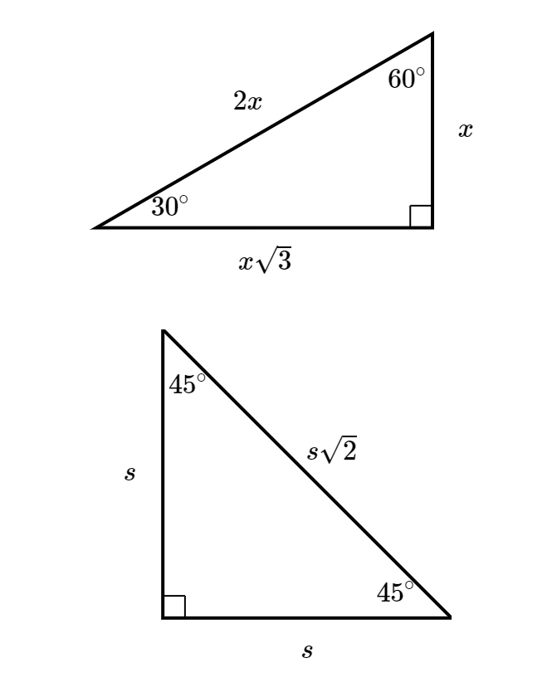

Special Right Triangles
Very (very!) common—
be able to recognize them
Note: Questions might also ask you about the measurement of a side length when you are only given one side.
If so, you need to find x.
30-60-90
triangle
45-45-90 triangle
Notes:
These are located in the SAT reference table, however you need to be able to recognize them- commonly by the angles
Then you need to apply the side length relationships

Slide 5
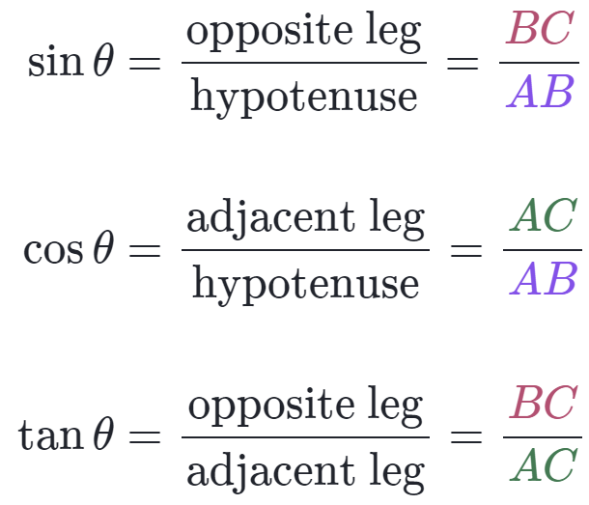
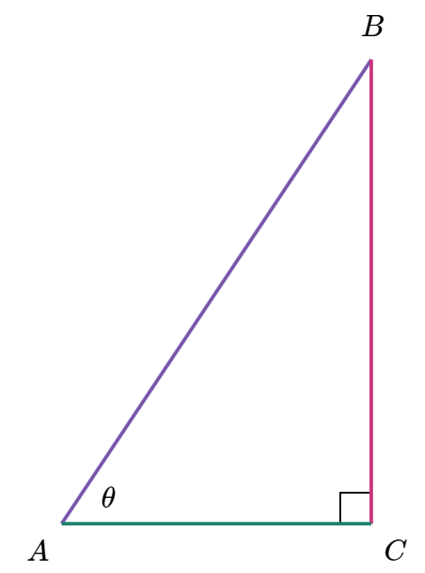
SOHCAHTOA
Based off of the location of θ and the side lengths of a right triangle
Hypotenuse
(always across from right angle)
Opposite
Adjacent
Notes:
Memorize SOH CAH TOA

Slide 6
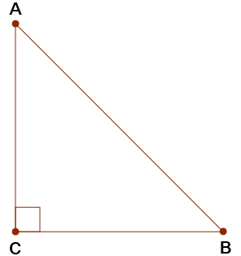
Trigonometry Ratios
Sine, cosine, and tangent represent ratios of side lengths—so can be used to find them!
For example if sin(B) = 3/5
The side lengths of the opposite side and the hypotenuse are in a 3/5 ratio (9/15)
15
9
Hypotenuse
Opposite
Adjacent
Notes:
Understand that the SOH CAH TOA fractions do NOT always correlate to the actual side lengths! They are RATIOS of the side lengths, and you need to recognize that for harder questions!

Slide 7

Last Tips
Understand what the problem is looking for before you jump in!
If you’re not provided with a diagram, it can help to draw one and fill in all the information you’re given.
Similar Triangles vs. Congruent Triangles
(angles are equal) (angles and sides are equal)
15
Also, one rule that sometimes comes up:
Notes:
Understand that the SOH CAH TOA fractions do NOT always correlate to the actual side lengths! They are RATIOS of the side lengths, and you need to recognize that for harder questions!

